Slide 1



"Brew happiness"
Notes:
1

Slide 2

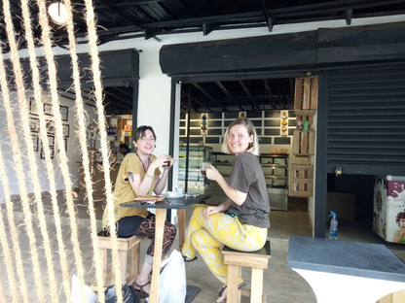
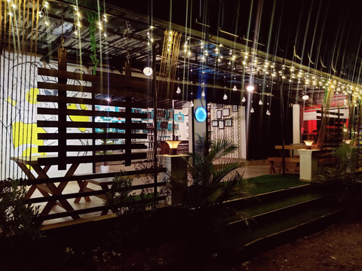
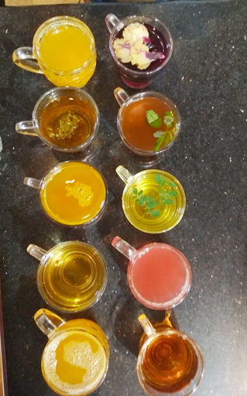
ABOUT US
Jomga began as a small tea café called Tea Scoup in the misty hills of Munnar, Kerala. What started as a humble passion project of tea lovers grew into a vibrant destination offering 60+ unique tea varieties — floral, fruity, spiced, and bold — all under one roof.
Inspired by local experiences and driven by curiosity, we asked:
“Why can’t Munnar, the land of tea, serve the world its finest cup?”
From that question, Jomga was born.
From the roots of that beloved café sprouted Jomga, a premium tea brand founded to bring that same soulful, diverse tea experience to the homes of every Indian.
Jomga stands for:
✅ High-quality teas sourced ethically from the best tea gardens of India.
✅ Innovative blends combining tradition and wellness.
✅Modern branding & eco-conscious packaging that appeals to the new generation.
We are not just a tea brand — we are curators of taste, aroma, and memory.
Every cup of Jomga tea tells a story of craftsmanship and care.

Slide 3



VISION
To become India’s most loved and trusted tea brand, enriching lives with authentic, high-quality teas while championing sustainability, fair trade, and community empowerment.
MISSION
To craft and deliver premium, diverse tea experiences rooted in sustainability, ethical sourcing, and continuous innovation — bringing India’s finest teas to the world, one soulful cup at a time.

Slide 4

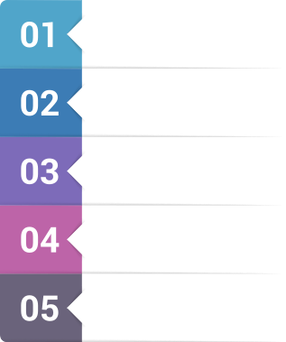

KEY INDUSTRY CHALLENGES
Lack of Variety in Mainstream Offerings
Most tea brands offer only basic options like masala chai or plain Assam/Darjeeling blends, limiting consumer exploration.
Low Transparency in Sourcing
Many mass-market brands lack clarity around where their tea comes from, how it’s grown, or whether it’s ethically sourced.
Commoditization of Tea
Tea is treated as a cheap, daily commodity rather than a premium lifestyle product, which undervalues its cultural and health potential.
Lack of Connection Between Brand and Experience
Most tea brands are disconnected from the actual café or tasting experience, making the brand feel impersonal.
Eco-Concerns Around Packaging
Single-use plastics and non-biodegradable packaging dominate the market.

Slide 5




SOLUTION - WE PROVIDE
Innovative Tea Blends
Jomga offers a diverse range of premium teas — floral, fruity, wellness, and classic — going beyond the basics to excite modern consumers.
Bridging Local Roots to Global Reach
Ethical Sourcing & Sustainability
From Munnar to the world — Jomga is building a strong D2C presence, offline retail network, and plans to export India's finest teas globally.
We source directly from trusted plantations, ensuring fair trade and promoting eco-conscious practices through biodegradable packaging.
Authentic Brand with Modern Appeal
Rooted in a real café experience, Jomga combines authentic origin stories with contemporary design and branding that resonates with today’s market.

Slide 6
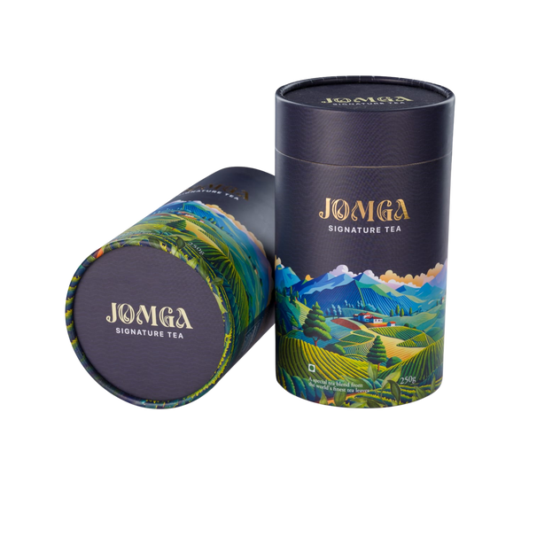
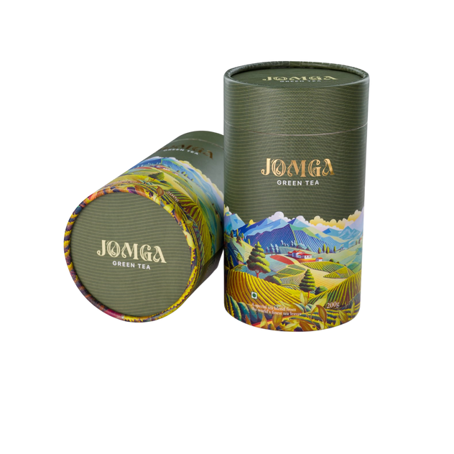
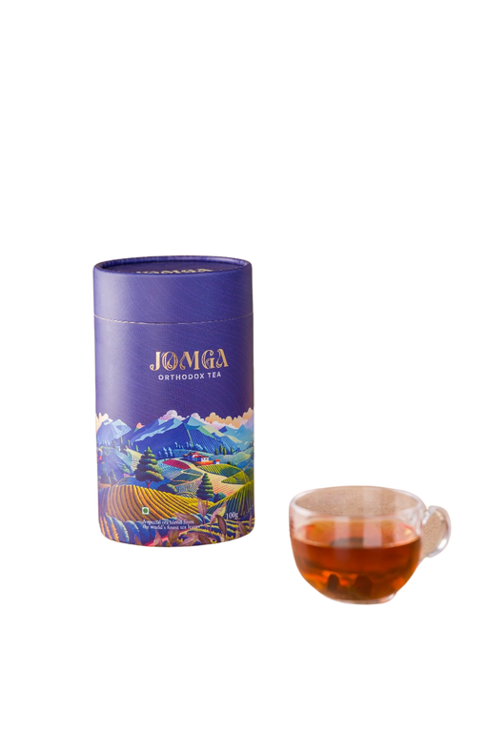
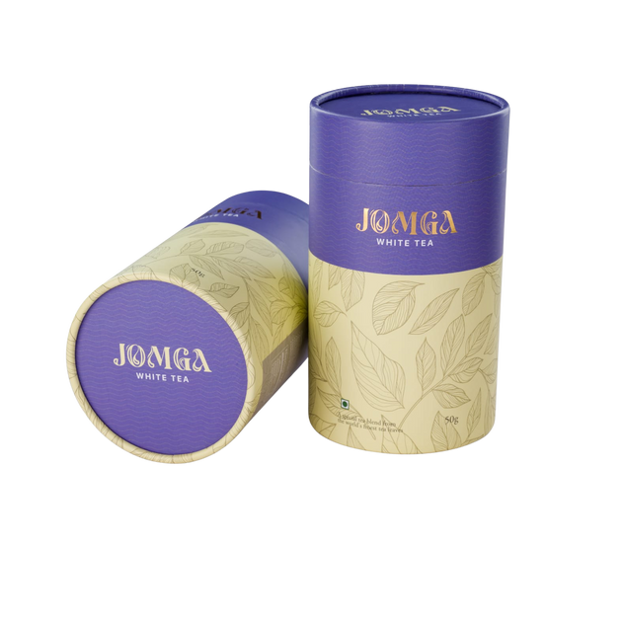
OUR PRODUCTS
SIGNATURE TEA
GREEN TEA
ORTHODOX TEA
WHITE TEA

Slide 7


MARKET SIZE
Global Tea Market
Estimated at USD 79.77 billion in 2025, expected to reach USD 108.46 billion by 2030.
6.34%
CAGR
SOURCE- SOURCE-www.giiresearch.comom
INDIA TEA MARKET
Market Size: Valued at USD 2.12 billion in 2024, projected to reach USD 2.81 billion by 2030.
4.8%
CAGR
SOURCE-www.grandviewresearch.com

Slide 8
OUR TARGET MARKET: REACHING EVERY TEA LOVER
SEGMENTATION
TARGETING
POSITIONING
Demographics: Age 25–45, urban professionals, health-conscious millennials, and NRIs.
Psychographics: Consumers who value authenticity, premium quality, wellness, and aesthetic lifestyle choices.
Behavioral: Regular tea drinkers, gift-seekers, café explorers, and those seeking variety and personalization in their beverage choices.
Are willing to pay for quality and experience.
Value sustainability, health, and craftsmanship.
Prefer online shopping, boutique stores, and curated cafés.
Are explorative and seek new flavors beyond traditional masala chai.
“Jomga Tea is positioned as a premium, ethically sourced tea brand that brings the richness of Munnar’s tea heritage to the modern world through unique blends, sustainable practices, and soulful experiences.”
Brand Pillars:
Authenticity
Innovation
Sustainability
Experience-first

Slide 9






OUR UNIQUENESS: SETTING US APART
Café-Origin Brand with Proven Taste Experience
Premium Blends with Creative Innovation
Unlike most packaged tea brands, Jomga was born in a real café — Tea Cups in Munnar — where its 60+ blends were tested, loved, and perfected with real customers before becoming a brand.
From jasmine-lavender fusion to fruit-infused chai, Jomga offers artisanal blends that go beyond traditional tea — delivering a modern, wellness-focused tea experience.
Designed for Global & Indian Palates
Ethical & Sustainable Sourcing
With elegant packaging, D2C presence, and export-ready blends, Jomga is built to appeal to both Indian tea lovers and international wellness consumers looking for authenticity.
Jomga partners with eco-conscious tea plantations, ensuring fair trade, farmer welfare, and clean, sustainable ingredients, aligning with today’s responsible consumer mindset.

Slide 10




OUR GO-TO-MARKET STRATEGY: BUILDING A BRAND
Digital-First Launch & Performance Marketing
Leverage Instagram, Facebook, and Google Ads to target urban millennials and wellness-focused consumers. Use storytelling, influencer marketing, and user-generated content to build brand engagement.
Selective Retail & Café Partnerships
Strategically place products in premium grocery outlets, boutique stores, wellness centers, and branded tea cafés that match Jomga’s lifestyle vibe.
Sampling, Events & Gifting Campaigns
Distribute trial packs via curated wellness boxes, conduct live tastings at events, and push corporate gifting collaborations during festive seasons.
Export-Ready Branding & Global Distributor Ties
Develop export-friendly SKUs and packaging tailored for global markets. Participate in international food expos and partner with NRI-focused retailers.

Slide 11




OUR SCALE-UP PLAN: BUILDING A TEA EMPIRE
D2C Domination
Retail Footprint Expansion
Diversifying Product Line
Global Market Entry
Expand aggressively via jomgatea.com & online marketplaces with performance-driven digital marketing to build a loyal customer base.
Enter premium offline stores, wellness chains & boutique cafés across metros and Tier-2 cities through strategic B2B partnerships.
Introduce herbal, iced, and wellness teas, plus gifting editions and RTD formats to meet evolving lifestyle trends.
Launch exports to NRI-rich countries (USA, UAE, UK), participate in international expos, and collaborate with global retailers.
1
2
3
4

Slide 12



REVENUE MODEL
Café Sales & On-Site Experience
Revenue from our flagship “Tea Scoup” café in Munnar — a hub for direct sales and immersive tea experiences.
Direct-to-Consumer (D2C) E-commerce Sales
Tea products are sold via the official website and platforms like Amazon & Flipkart.
Retail & Distributor Sales
Supplying to offline stores, premium supermarkets, gourmet and wellness outlets across India.
Gifting, Subscription & Export (Expansion Path)
Future-ready revenue from corporate gifting, monthly subscription boxes, and international exports.

Slide 13
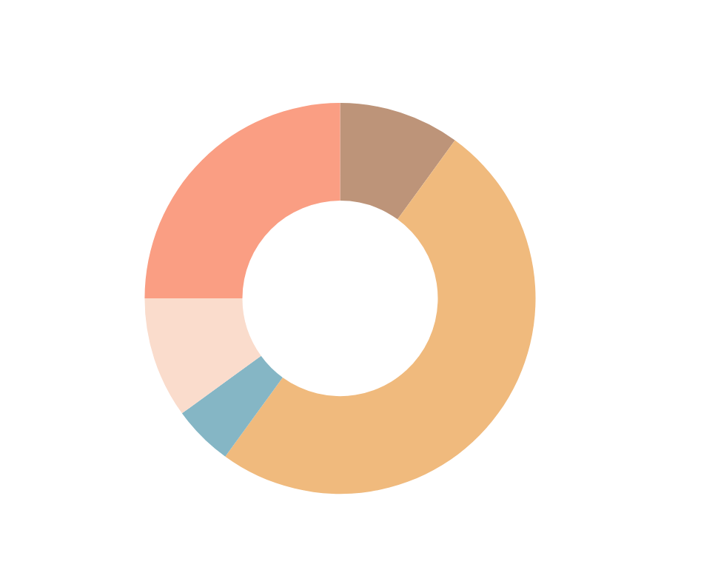
FUND UTILIZATION
We’re asking 20 lacs as a Fund under
SEED FUND >>>
Fund Required (Rs): | 20,00,000
Research & Development and Market Analysis | 2,00,000
Product Development (Diversify Tea Product Lines) | 10,00,000
Testing & Quality Cost | 1,00,000
Pre-Development Marketing & Branding | 2,00,000
Initial Operational Cost | 5,00,000

Slide 14


BRAINSTORMER
Meghanand TS
(Managing Director & CEO)
ED. :- MBA (Marketing)
Business Experience:- 10+ years of experience in sales and marketing with various MNCs

Slide 15






+91 97003 14314
+91 81295 10598
jomgatea.com
Blautopf ventures pvt ltd
NH 85, Iruttukanam
Munnar 685561
care@jomgatea.com

